Slide 1
Simple Social Network skeleton Angular + Ionic
Jan Pavlovský

Slide 2
The app overview
A simple skeleton for a social network allowing mupliple people add posts from their accounts
Displays all posts in a time-ordered Feed
Opens New Post creator in a Modal
Allows deleting only own posts
Allows to Update own post in the same manner as to create (postponed)

Slide 3
Architecture
Typescript + Angular + Ionic
Firebase firestore realtime web document database
Simple MVVM
Unrestricted access for testing purposes for the time being..(no authentication, authorization simulated for the test user – currently possible delete or update anything)

Slide 4
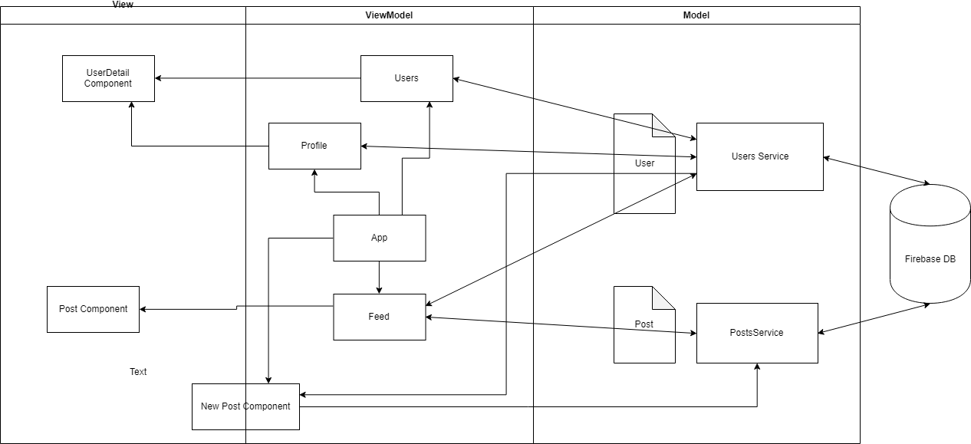
Angular App UML

Slide 5
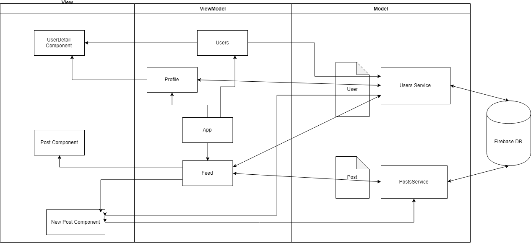
Ionic App UML

Slide 6
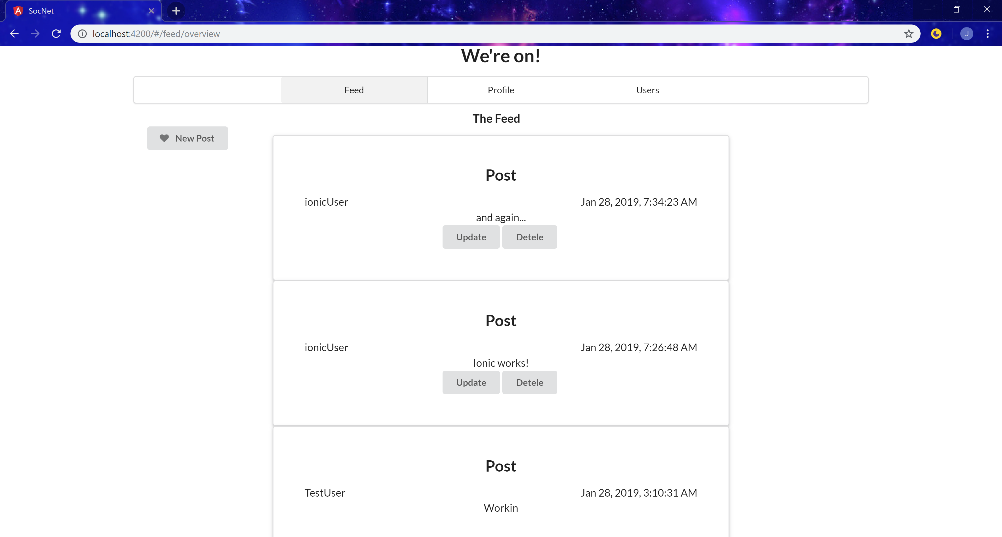
Angular basic screens

Slide 7
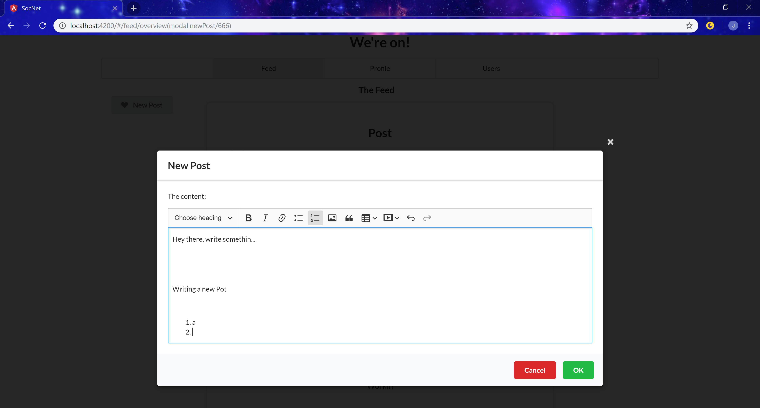
Adding post in a modal

Slide 8
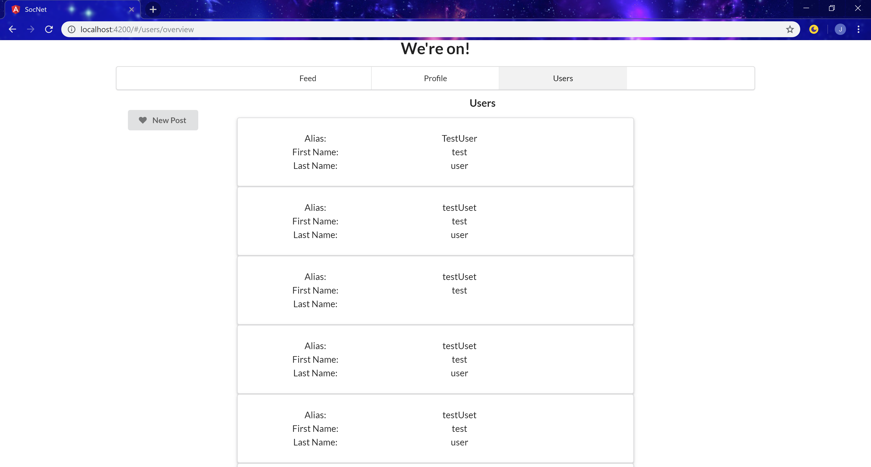

Slide 9
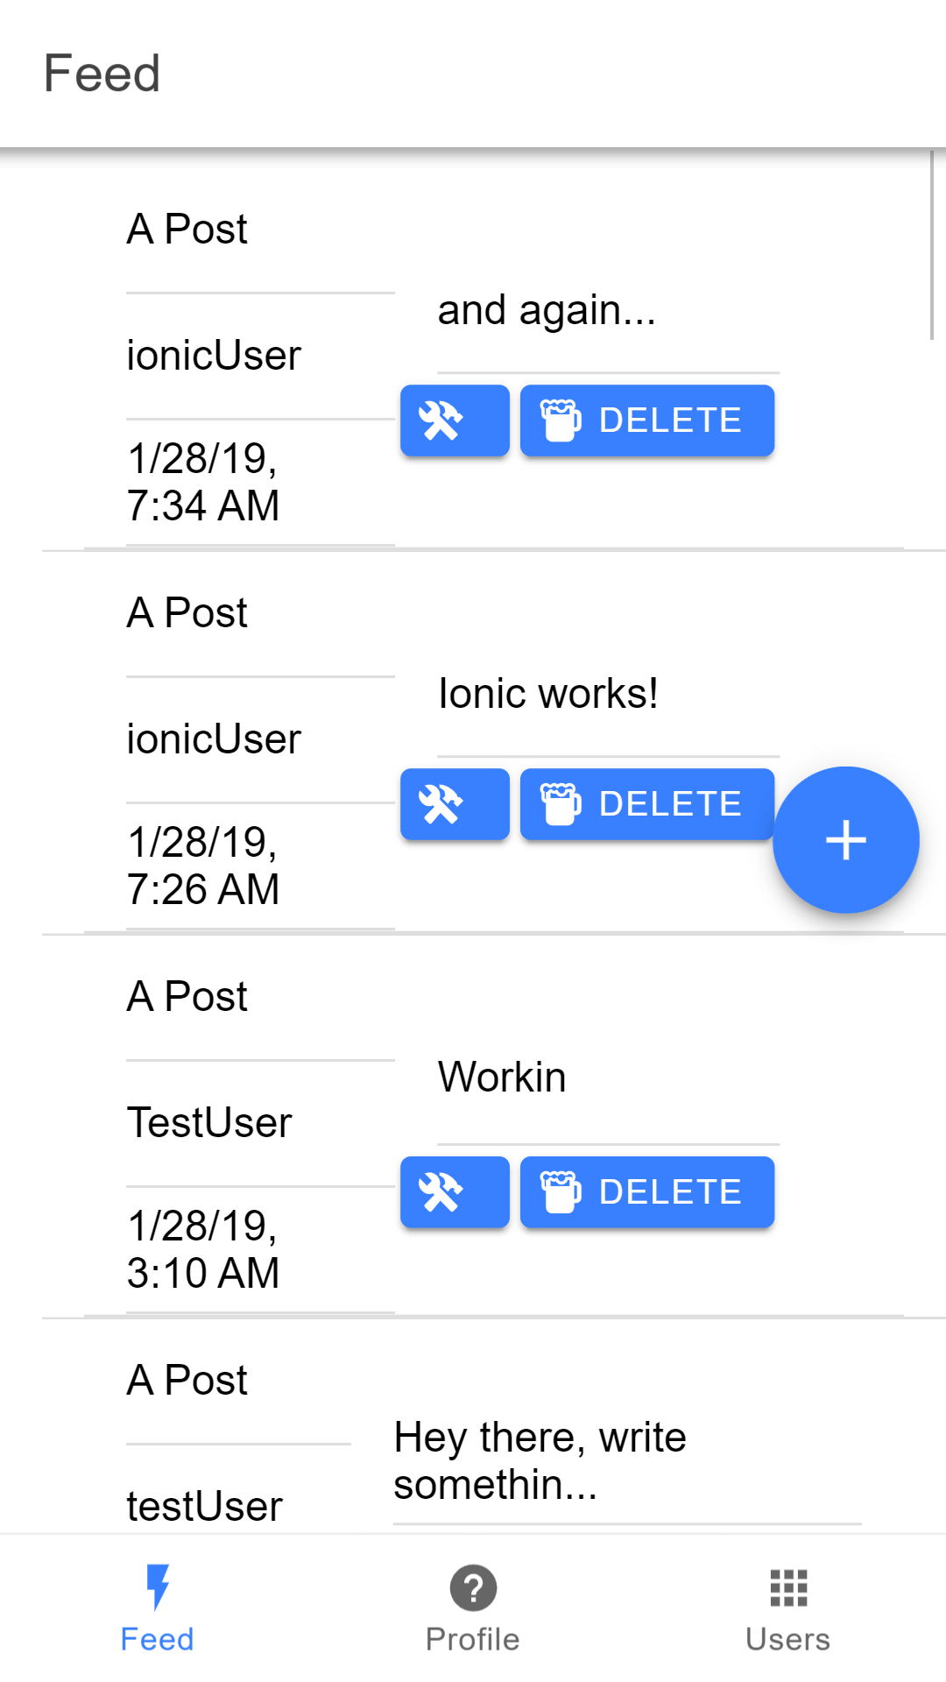
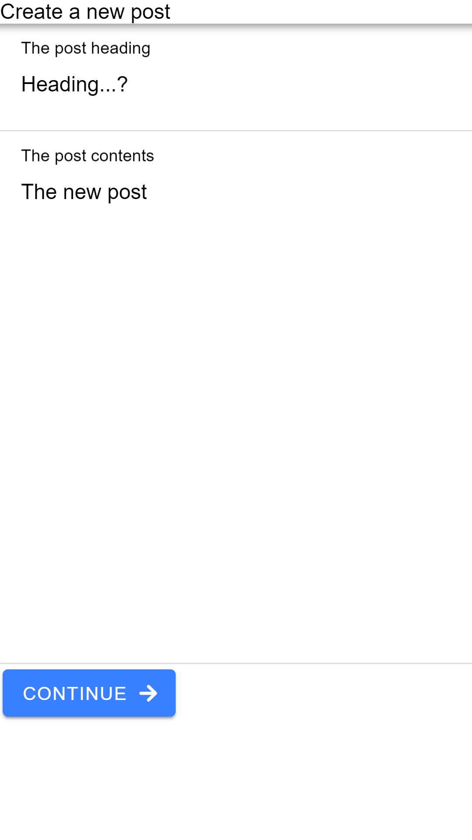
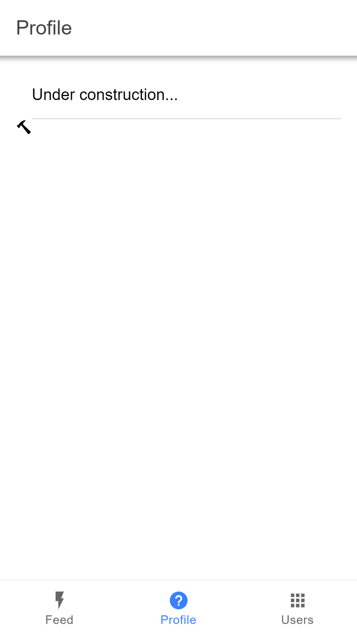
Ionic App Basic screens

